Slide 1

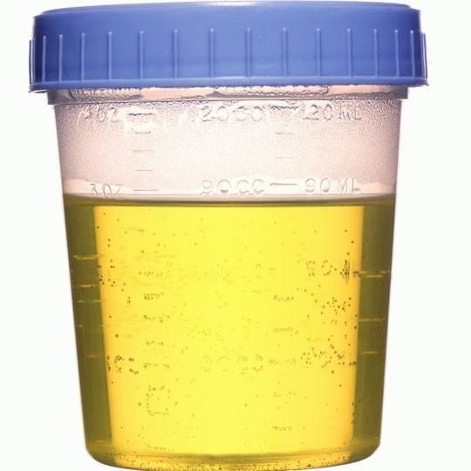
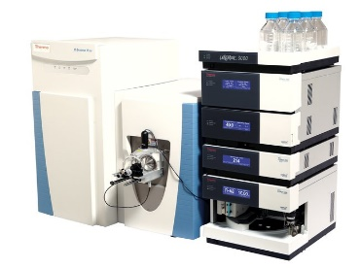

Discovery Cohort
n=329, 30 subjects
Delivery
Weekly Urine Samples
PP
Global Metabolomics

